Slide 1
Office 365 Development

Slide 2



Recap
Introduction to Office 365 development
Module 1: Introduction to Office 365 development
Module 2: Getting started with Apps for Office
Module 3: Getting started with Apps for SharePoint
Module 4: Moving Full Trust Code to the Cloud Using Repeatable Patterns and Best Practices
Module 5: Getting started with the Office 365 APIs
dev.office.com/training

Slide 3
Course Agenda
Deep Dive into Integrating Office 365 APIs with Web Applications
Module 1: Deep Dive into Azure AD with the Office 365 APIs
Module 2: Deep Dive into Office 365 APIs for Calendar, Mail, and Contacts
Module 3: Deep Dive into Office 365 APIs for OneDrive for Business
Module 4: Deep Dive into Office 365 APIs for SharePoint Site services
Module 5: Deep Dive into Office 365 APIs for Yammer services
Module 6: Deep Dive into Office 365 APIs for Office Graph
Module 7: Deep Dive into Office 365 APIs for OneNote services

Slide 4
Deep Dive into Office 365 APIs for OneDrive for Business

Slide 5

Agenda
Overview
File Operations with SharePointClient
File Operations with REST

Slide 6















Vision
EXTEND OFFICE EVERYWHERE
CONNECT TO OFFICE 365 SERVICES
BUILD USING AN OPEN PLATFORM
Delve
z
Users and groups
Files
Mail
Calendar
My Apps
Video Portal
Contacts
Office Graph
Presentations
Documents
Spreadsheets
Lync
OneNote
Yammer

Slide 7
Overview

Slide 8

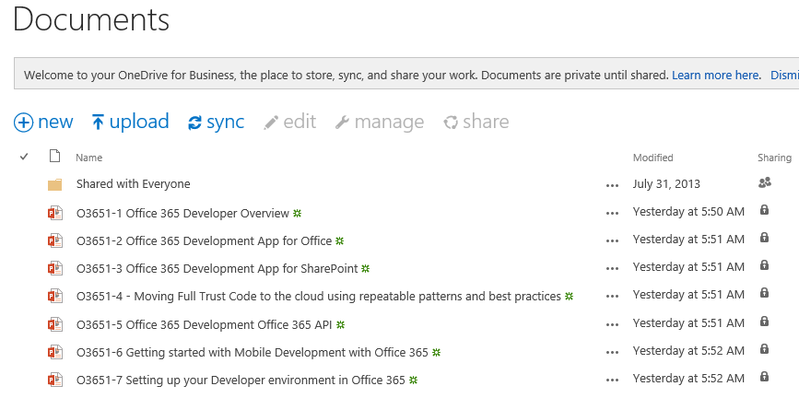
OneDrive for Business
A personal library for storing and organizing your work documents
Notes:
OneDrive for Business is a personal library intended for storing and organizing your work documents. As an integral part of Office 365 or SharePoint Server 2013, OneDrive for Business lets you work within the context of your organization, with features such as direct access to your organization’s address book.
Note OneDrive for Business is different from OneDrive, which is intended for personal storage separate from your workplace. OneDrive for Business is also different from your team site, which is intended for storing team or project-related documents.

Slide 9
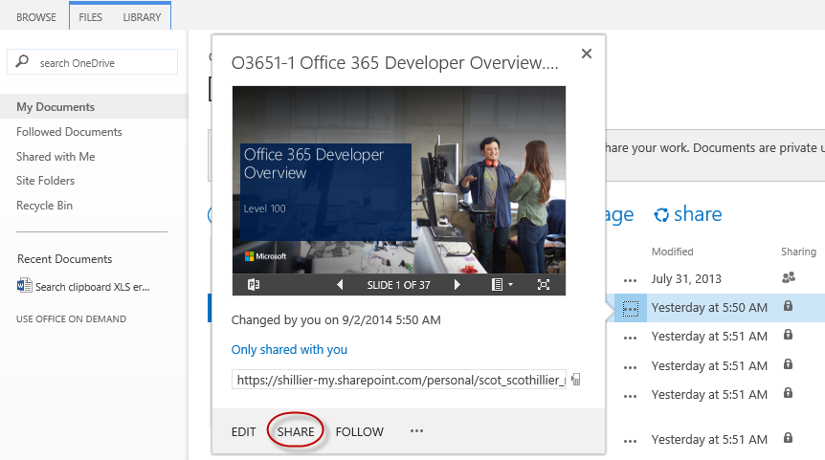
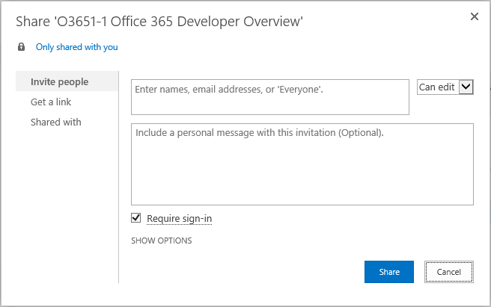
OneDrive for Business Sharing
Notes:
The documents and folders you store in OneDrive for Business are private until you decide to share them. When you share documents and folders, you can decide whether to let people edit them, or just view them. You can also share documents or folders in a site library.
Note If you’re using Office 365, you may be able share documents with external users (people not on your network) by inviting them as “Guests,” or by creating and posting guest links

Slide 10
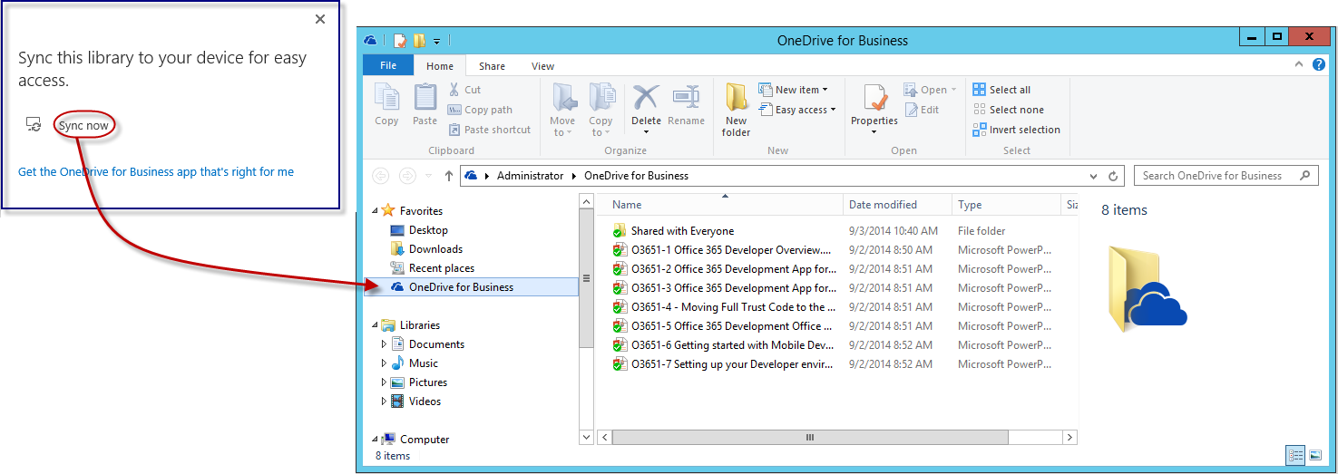
OneDrive for Business Sync
Notes:
The OneDrive for Business sync app lets you synchronize your OneDrive for Business library or other SharePoint site libraries to your local computer. This sync app is available with Office 2013 or with Office 365 subscriptions that include Office 2013 applications. If you don’t have Office 2013, a free download of the OneDrive for Business sync app is also available.
To sync OneDrive for Business, sign in to Office 365 or SharePoint, select OneDrive at the top of the page, and then click Sync.
You’ll find your synchronized files in your File Explorer, under Favorites. If you’re syncing an Office 365 OneDrive for Business library, your synchronized files appear in the OneDrive@<organization> folder. Work on them locally if you like and your changes will be synchronized automatically with your OneDrive for Business library when you’re online.

Slide 11
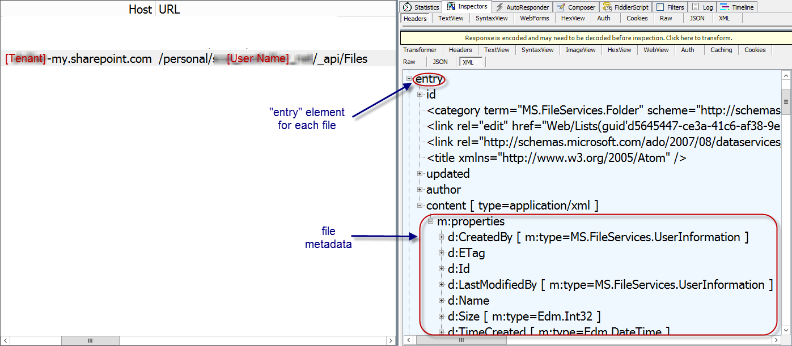
The Files API
https://[site]/_api/Files
Notes:
_api/Files always targets the “Documents” library in a SharePoint site
For personal sites, this is the OneDrive for Business library

Slide 12
File Operations with SharePointClient

Slide 13
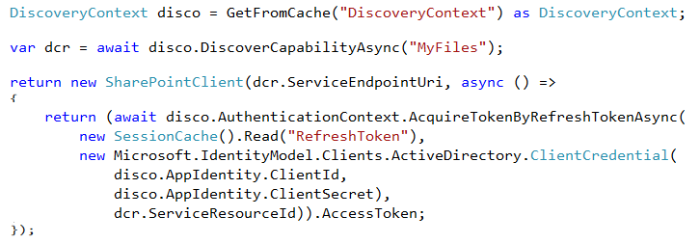
SharePointClient class
Discovery Service discovers “MyFiles” capability
Returns tenant and user-specific URL for user’s OneDrive for Business
SharePointClient.Files abstracts Files API
Notes:
The discovery service discovers the “MyFiles” capability, which will always try to access the OneDrive for Business library

Slide 14
Reading File Metadata
Read Files collection
Can also read an individual Folder
Notes:
No support for $skip and $orderby so paging is post-query

Slide 15

Uploading a new File
Use AddAsync method
Provide a file name and the file stream

Slide 16
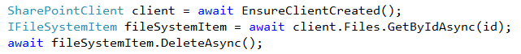
Deleting a File
Get the target file using GetByAsync method
Delete using DeleteAsync method

Slide 17
demo
File operations with the SharePointClient

Slide 18
File Operations with REST

Slide 19
OneDrive for Business Files REST API
Get the metadata for all files in OneDrive
GET http://<onedrive>/_api/Files
Get the metadata for a folder in OneDrive
GET http://<onedrive>/_api/Files('folder')
Get the metadata for the children of a folder in OneDrive
GET http://<onedrive>/_api/Files('folder')/Children
Get the metadata for a single file in OneDrive
GET http://<onedrive>/_api/Files('folder/filename.docx')
Download a single file from OneDrive
GET http://<onedrive>/_api/Files('folder/filename.docx')/download

Slide 20
OneDrive for Business Files REST API
Upload a file to the specified path in OneDrive (pass file in body)
POST /_api/Files/Add(name='folder/filename.docx',overwrite=<bool>)
Delete a file from OneDrive
DELETE /_api/Files('folder/filename.docx')
Get metadata for a folder and its children
GET /_api/Files('folder')?$expand=Children
Get on selected metadata fields back for first 5 files in OneDrive
GET /_api/Files?$select=Name,Id,TimeCreated,Size&$top=5
Use Files API on other document libraries
GET /_api/Lists/GetByTitle('ListTitle')/Files

Slide 21
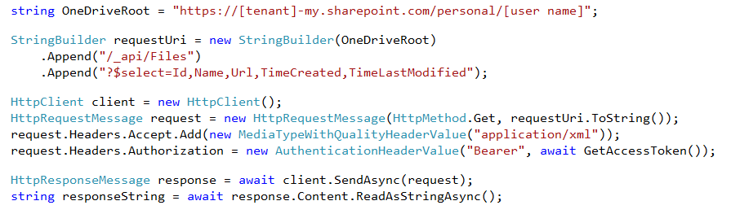
Reading File Metadata
GET Files endpoint
Paging is accomplished post-query using LINQ
Notes:
No support for $skip and $orderby so paging is post-query
Note that the OneDrive URI is hard-coded just for clarity. Normally, you would get this from the discover service.

Slide 22
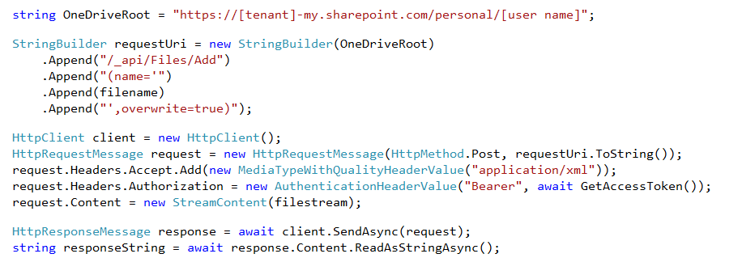
Uploading a new File
POST to Add endpoint
Provide a file name and the file stream
Notes:
Note that the OneDrive URI is hard-coded just for clarity. Normally, you would get this from the discover service.

Slide 23
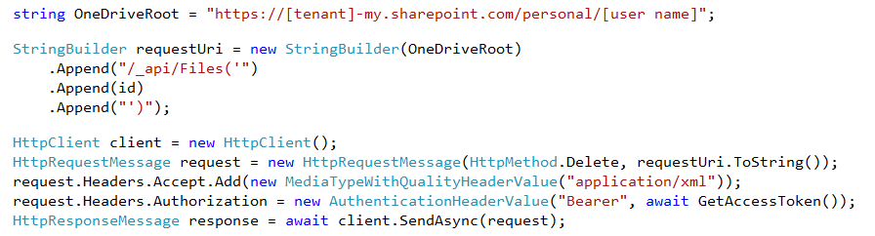
Deleting a File
DELETE the target file ID
Notes:
Note that the OneDrive URI is hard-coded just for clarity. Normally, you would get this from the discover service.

Slide 24
demo
File Operations with REST

Slide 25
Summary
Overview
File Operations with SharePointClient
File Operations with REST

Slide 26


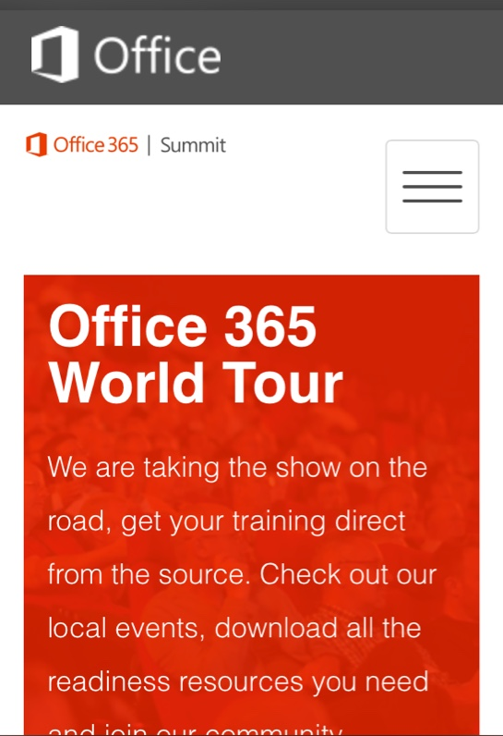
dev.office.com
Sign up
http://dev.office.com/getting-started
Explore
http://apisandbox.msdn.microsoft.com
Get trained http://dev.office.com/training

Slide 27


Feedback
Office 365 Network Share you best practices and join conversations https://www.yammer.com/itpronetwork
Stackoverflow Ask deep technical questions to a world-wide set of developers
http://stackoverflow.com/questions/tagged/ms-office
UserVoice Provide suggestions of what you want in future versions
http://officespdev.uservoice.com/

Slide 28

© 2014 Microsoft Corporation. All rights reserved. Microsoft, Windows, and other product names are or may be registered trademarks and/or trademarks in the U.S. and/or other countries.
The information herein is for informational purposes only and represents the current view of Microsoft Corporation as of the date of this presentation. Because Microsoft must respond to changing market conditions, it should not be interpreted to be a commitment on the part of Microsoft, and Microsoft cannot guarantee the accuracy of any information provided after the date of this presentation. MICROSOFT MAKES NO WARRANTIES, EXPRESS, IMPLIED OR STATUTORY, AS TO THE INFORMATION IN THIS PRESENTATION.

